Slide 1


Slide 2
Chapter 3
INTRODUCING LISTS
Brief Summary of Chapter 3
In this section, we will be covering lists in Python, a powerful tool for storing and organizing multiple items in a specific order. You’ll learn how to create lists, access and modify items, by using functions like append(), insert(), del, pop(), and remove() to add or remove elements. Lists can also be sorted with sort() and reversed with reverse(), and the len() function helps you determine how many items are in a list. The section also explains how to avoid common errors, like trying to access items that don’t exist, making lists essential for managing and manipulating data in Python.

Slide 3
List
A list in Python is a collection of items stored in a specific order. Each item in the list is assigned a position, known as an index, which you can use to access the items. Index positions in Python start at 0, not 1, meaning the first item in a list is at position 0, the second item is at position 1, and so on. To access an element, you write the name of the list followed by the index inside square brackets, like list[0] for the first item.
If you want to use the values from a list, you can include them in strings using f-strings. F-strings allow you to embed variables directly inside a string by prefixing it with f and using curly braces {} around the variable or expression.
For example, you could access an element from a list and use it in a sentence, and format it with methods like title(). The title() method capitalizes the first letter of each word in a string, which is useful for formatting values like names or titles to appear properly in sentences. This is an efficient and readable way to include dynamic data in strings.

Slide 4
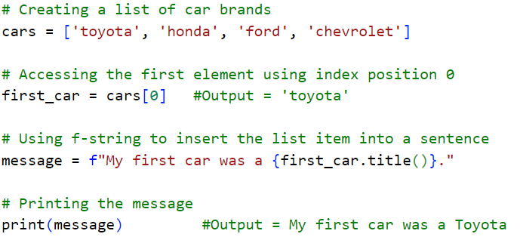

Slide 5
Changing, Adding, and Removing Elements
In Python, you can easily change, add, and remove elements from a list using various methods. To modify an element in a list, simply access it by its index and assign a new value. You can add new items to a list by appending them to the end with the append() method, or by inserting them at any position using insert().
To remove items, you can use the del statement if you know the index of the element you want to remove, or the pop() method, which not only removes an item but also returns the removed element, making it useful when you need to work with the value. pop() can be used to remove an item from any position in the list by specifying the index.
If you know the value of the item you want to remove, you can use the remove() method, which deletes the first occurrence of that value. These operations allow you to manage lists dynamically, adding, changing, or deleting elements as needed in your program.

Slide 6
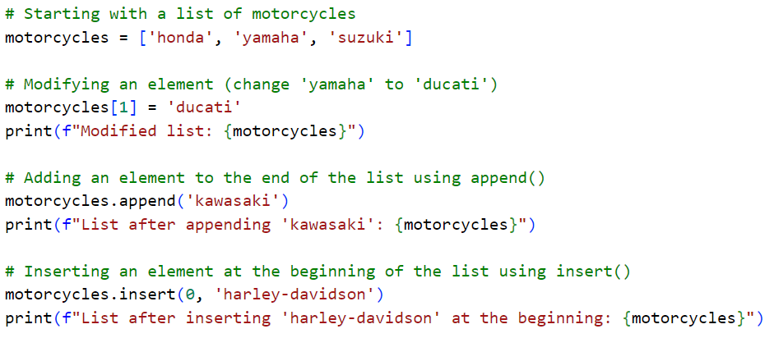

Slide 7
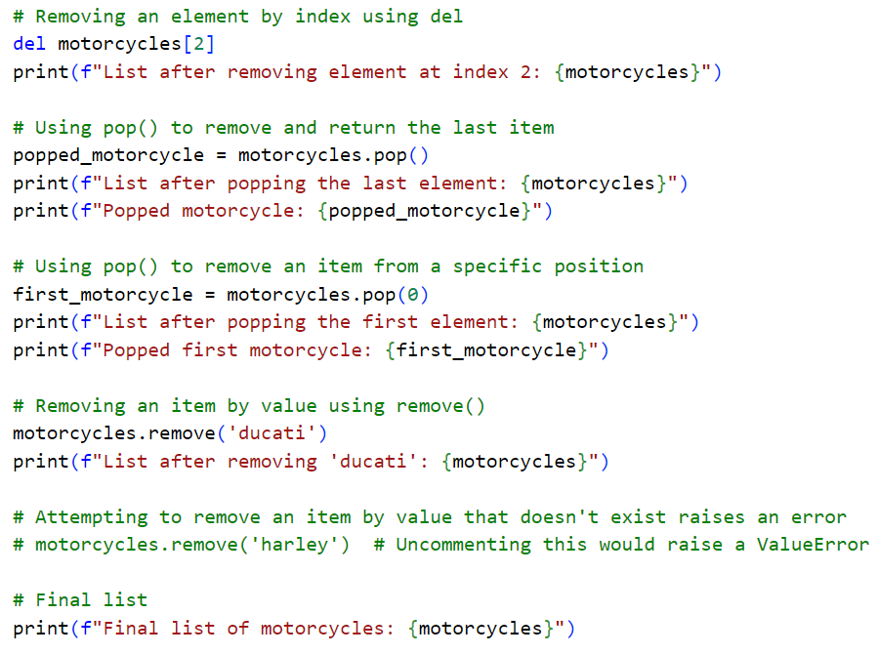

Slide 8
Organizing a List
Organizing a list in Python allows you to arrange the items in a specific order based on your needs. The sort() method permanently sorts a list in ascending order, while you can also reverse this order by using the reverse=True argument with sort().
If you want to display the list in a sorted order without altering the original list, you can use the sorted() function, which returns a new sorted list. To reverse the list’s order, you can use the reverse() method, which changes the order permanently, but can be undone by applying reverse() again.
Additionally, you can find the length of a list using the len() function, which gives you the number of items in the list. These tools allow you to effectively organize, manipulate data stored in lists.

Slide 9
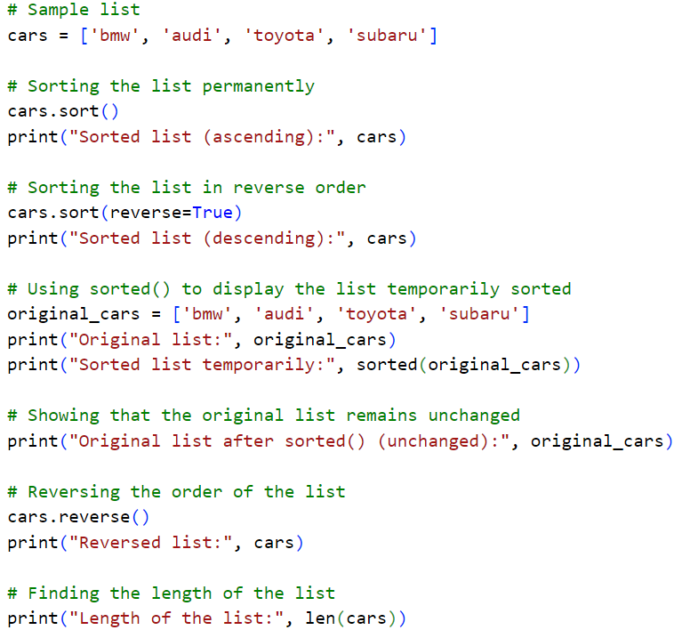

Slide 10
Avoiding Index Errors When Working with Lists
When working with lists in Python, you can run into IndexError if you try to access an index that doesn’t exist. List indices start at 0, so the first item is at index 0, the second at index 1, and so on. If you try to access an index beyond the list’s length, you’ll get an error. To avoid this, ensure the index is within the list’s range. Python also supports negative indexing, where -1 refers to the last item, -2 to the second-to-last, and so on. However, trying to access an item from an empty list will also cause an IndexError. Always check the list’s length or use negative indices to prevent errors.

Slide 11
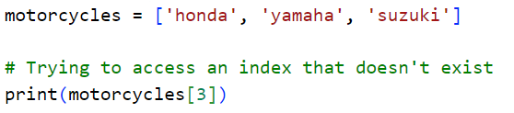
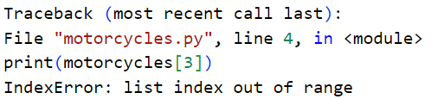
ERROR MESSAGE:

Slide 12
Practice Exercises
Do the follow TRY IT YOURSELF on pages:
36
41
45
47

Slide 13

End
Of
Chapter 3

